Slide 1
Multi Energy Systems (MES) Investigating Unknown Flexibilities Provided by Power-to-X Converters Considering Grid Support Strategies
Supervisor: Asst. Prof. Milos Cvetkovic
PhD: Digvijay Gusain
MSc: Bekir Caner Yagci (4857089)
Delft University of Technology
Faculty of Electrical Engineering,
Mathematics, and Computer Science

Slide 2
Content
Problem
Research Questions
Methodology
Modelling
Cases & Results
Further Improvements

Slide 3
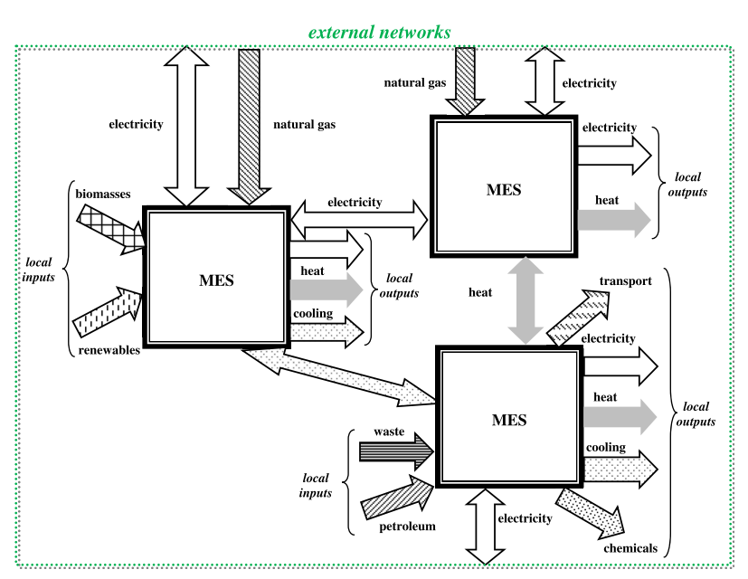
Problem
Energy systems need more flexibility and ways to measure it
Power-to-X systems are able to provide this flexibility
However, existing models are too simplified for control and flexibility analysis
P. Mancarella, “MES ( multi-energy systems ): An overview of concepts and evaluation models,” Energy,vol. 65, pp. 1–17, 2014.

Slide 4
Research Questions
What are the hidden flexibilities provided by Power-to-X modelling? (Demand-side flexibility, Demand Side Management)
How much district heating demand can be supplied from curtailed renewable energy in Maasvlakte 2, Port of Rotterdam and what is its effect on system flexibility?
How the existing flexibility affected when another flexible load is connected to the system? (Supply-side flexibility, Curtailment)
This project investigates the impact of MES flexibility service providers on balancing the stochastic variability of renewable energy sources by using co-simulation in OpenModelica environment.

Slide 5
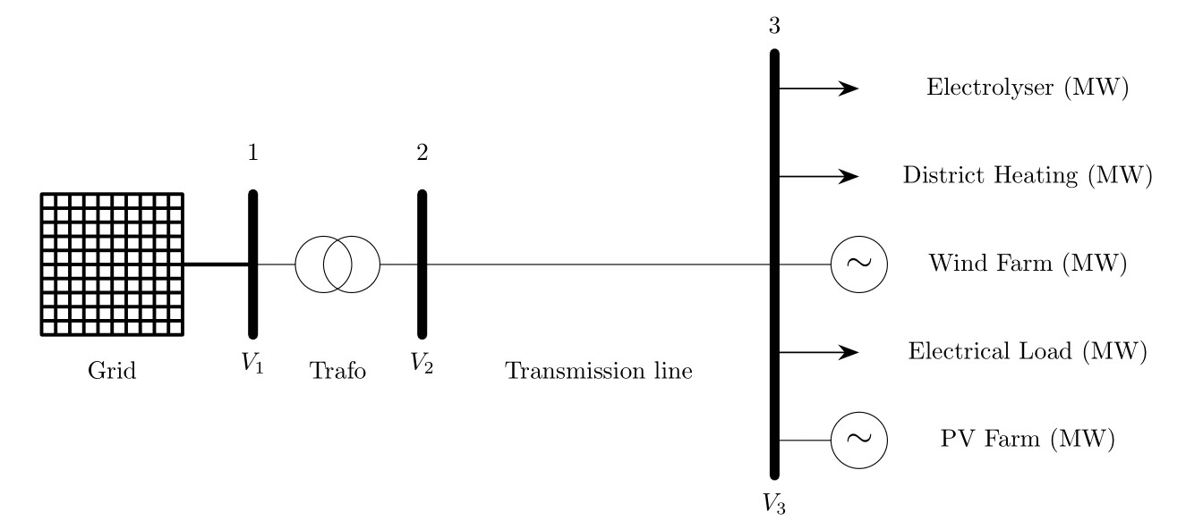
Methodology – Maasvlakte Energy Park
Notes:
The figure includes the
processes that allow for the storage and transport of electrical energy (Gray blocks)

Slide 6
Methodology – Flexibility
”Ability of a system to response challenges caused by power fluctuations [1]. ”
Electrical System Flexibility (for Grid Operator)
Supply-side Flexibility (Curtailment)
Demand-side Flexibility (DSM)
Cost Flexibility (for Indutry)

Slide 7
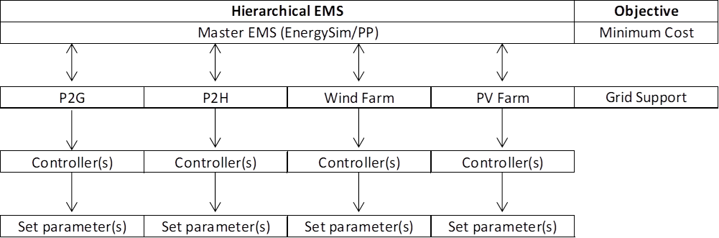
Methodology – Hierarchical Control

Slide 8
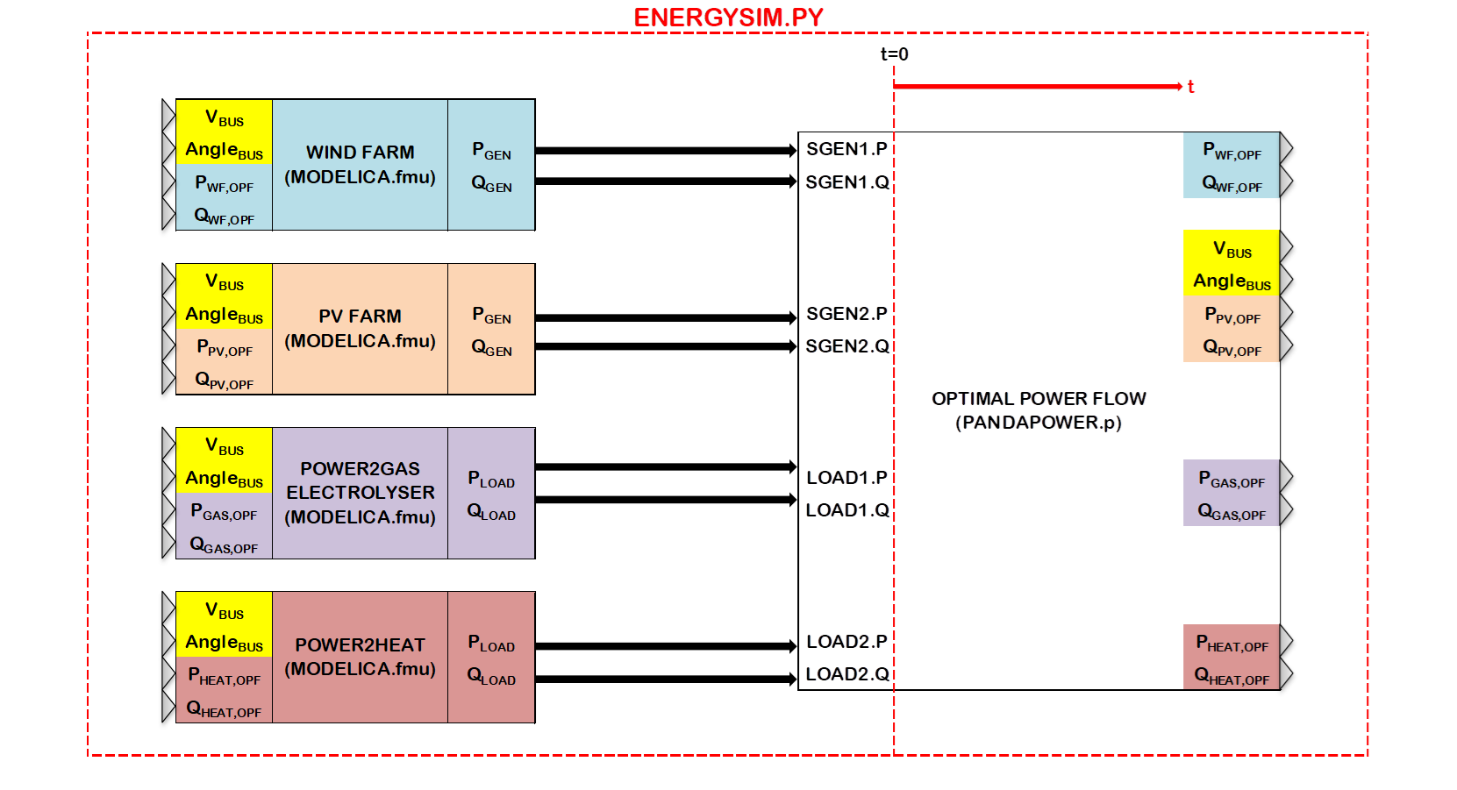
Methodology – Co-simulation

Slide 9
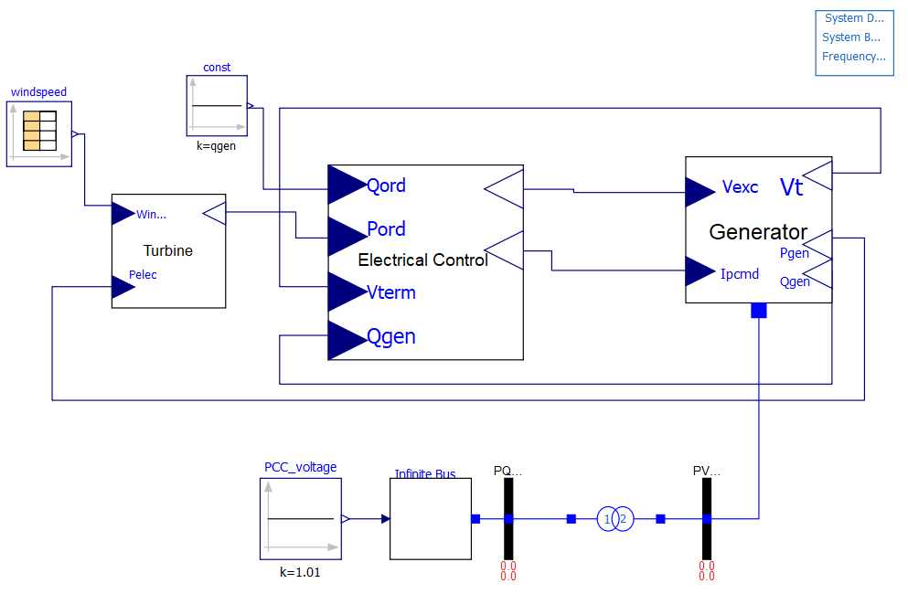
Modelling – Wind Turbine Generator

Slide 10
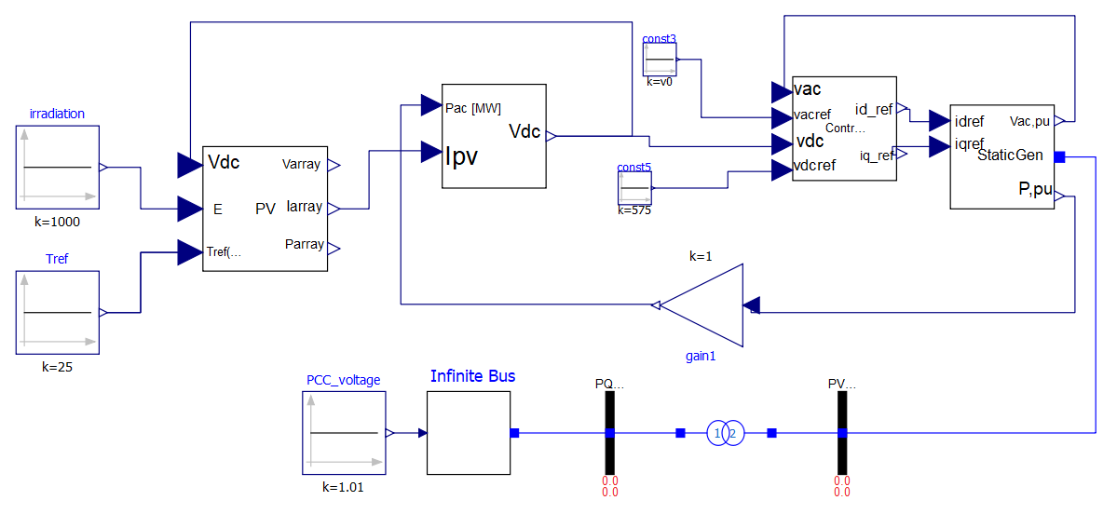
Modelling – PV Farm

Slide 11
Cases
First case:
Simulate P2G connected to RES and plot system parameters in Energysim. Measure the flexibility of electrolyser, system and excess RE.
Second case:
Connect P2H (flexible load) to the previous system and do the same measurements. Expecting reduced excess RE, better grid performance (less power injection to/from grid, more stable active power on feeder) and smaller storage size. Measure the flexibility.

Slide 12
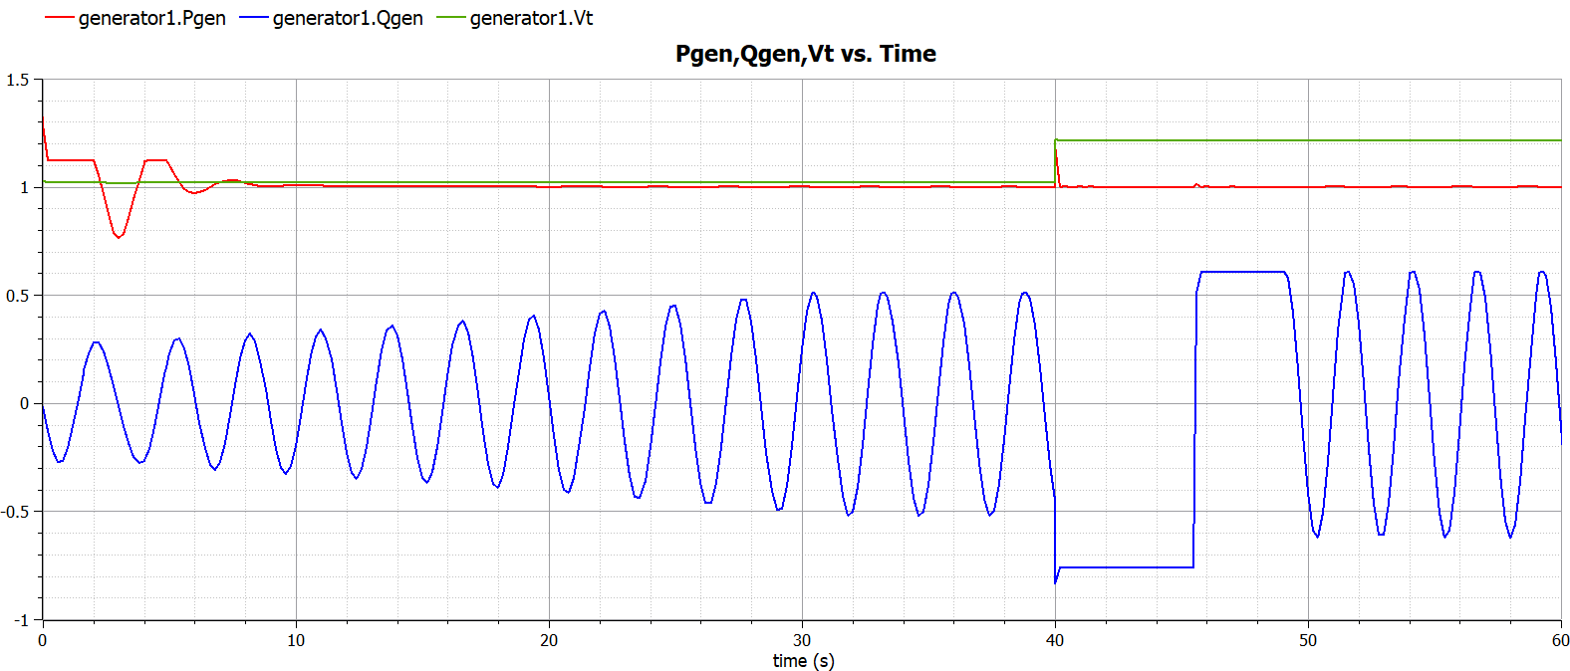
Initial Results

Slide 13
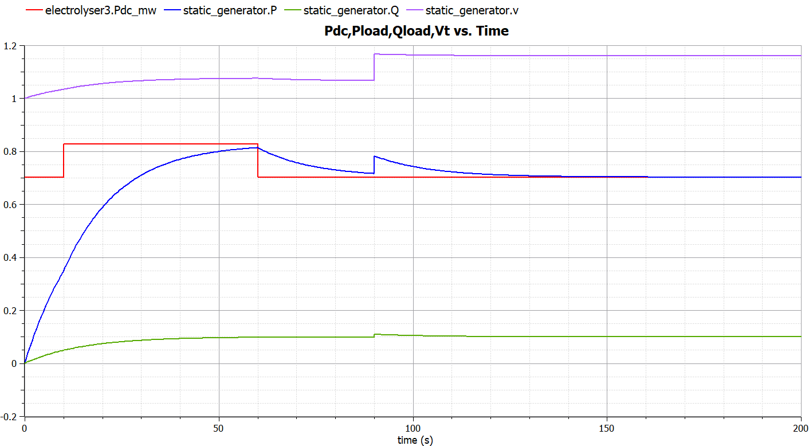
Initial Results

Slide 14
Conclusion & Expected Outcomes
Recommendations for,
Multi-energy system modelling for ancillary services and control
Flexibility Measurement and Analysis
Maasvlakte 2 RES
Flexibility(excess RE, power balance, cost) vs. t_{flex,on}
P,Q injected/withdrawn vs. time on feeder bus3

Slide 15
References
[1] P. Schott, J. Sedlmeir, N. Strobel, T. Weber, G. Fridgen, and E. Abele, “A generic data model for describing flexibility in power markets,” Energies, vol. 12, no. 10, pp. 1–29, 2019.

Slide 16
Multi Energy Systems (MES) Investigating Unknown Flexibilities Provided by Power-to-X Converters Considering Grid Support Strategies
Supervisor: Asst. Prof. Milos Cvetkovic
PhD: Digvijay Gusain
MSc: Bekir Caner Yagci (4857089)
E-mail: B.C.Yagci@student.tudelft.nl
Version Control: https://github.com/caneryagci/Multi-Energy-Systems-Thesis-Project.git

